Slide 1
Transducers
V.N.GANESH
Assistant Professor/EEE
SRMIST RAMAPURAM

Slide 2
Introduction
Transducer is defined as a device, which converts energy from one form to another. The energy may be electrical, mechanical, chemical, optical or thermal.
These are widely used in measurement work because not all quantities that need to be measured can be displayed as easily as others.

Slide 3
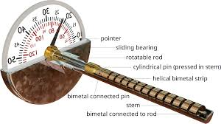
Mechanical Transducers
Mechanical transducers are a set of primary sensing elements that respond to changes in a physical quantity with a mechanical output.
They are simple and rugged in construction, cheaper in cost, accurate and operate without external power supplies.
Bimetallic Strip is a mechanical Transducer, which reacts to changes in temperature and responds with mechanical displacement.
The output mechanical quantity
can be anything like displacement,
force (or torque), pressure and strain.

Slide 4
Electrical Transducers
Electrical transducers are those that respond to changes in physical quantities with electrical outputs.
Mostly quantities to be measured are non-electrical such as temperature, pressure, displacement, humidity, fluid flow, speed etc., but these quantities cannot be measured directly. Hence such quantities are required to be sensed and changed into some other form for easy measurement.
Electrical quantities such as current, voltage, resistance. inductance and capacitance etc. can be conveniently measured, transferred and stored, and therefore, for measurement of non-electrical quantities these are to be converted into electrical quantities first and then measured.

Slide 5
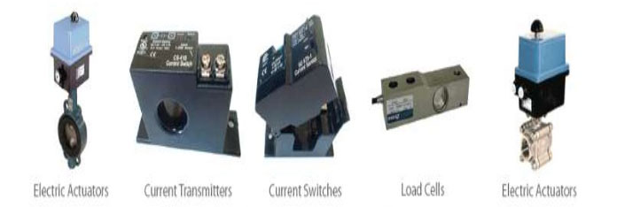
Electrical Transducers(cont’d)
The function of converting non-electrical quantity into electrical one is accomplished by a device called the electrical transducer.
Basically an electrical transducer is a sensing device by which a physical, mechanical or optical quantity to be measured is transformed directly, with a suitable mechanism, into an electrical signal.

Slide 6
BASIC REQUIREMENTS OF A TRANSDUCER
The main function of a transducer is to respond only for the measurement under specified limits for which it is designed. It is, therefore, necessary to know the relationship between the input and output quantities and it should be fixed. Transducers should meet the following basic requirements.

Slide 7
Basic Requirements Of a Transducer (cont’d)
Ruggedness. It should be capable of withstanding overload and some safety arrangement should be provided for overload protection.
Linearity. Its input-output characteristics should be linear and it should produce these characteristics in symmetrical way.
Repeatability. It should reproduce same output signal when the same input signal is applied again and again under fixed environmental conditions e.g. temperature, pressure, humidity etc.

Slide 8
Basic Requirements Of a Transducer (cont’d)
High Output Signal Quality. The quality of output signal should be good i.e. the ratio of the signal to the noise should be high and the amplitude of the output signal should be enough.
High Reliability and Stability. It should give minimum error in measurement for temperature variations, vibrations and other various changes in surroundings.
Good Dynamic Response. Its output should be faithful to input when taken as a function of time. The effect is analyzed as the frequency response.

Slide 9
Basic Requirements Of a Transducer (cont’d)
No Hysteretic. It should not give any hysteretic during measurement while input signal is varied from its low value to high value and vice-versa.
Residual Deformation. There should be no deformation on removal of local after long period of application.

Slide 10
CLASSIFICATION OF TRANSDUCERS
The transducers can be classified as:
Active and passive transducers.
Analog and digital transducers.
On the basis of transduction principle used.
Primary and secondary transducer
Transducers and inverse transducers.

Slide 11
ACTIVE AND PASSIVE TRANSDUCERS
Active transducers :
These transducers do not need any external source of power for their operation. Therefore they are also called as self generating type transducers.
The active transducer are self generating devices which operate under the energy conversion principle.
As the output of active transducers we get an equivalent electrical output signal e.g. temperature or strain to electric potential, without any external source of energy being used.

Slide 12
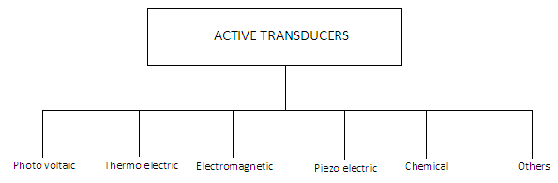
CLASSIFICATION OF ACTIVE TRANSDUCERS

Slide 13
ACTIVE AND PASSIVE TRANSDUCERS
Passive Transducers :
These transducers need external source of power for their operation. So they are not self generating type transducers.
A DC power supply or an audio frequency generator is used as an external power source.
These transducers produce the output signal in the form of variation in resistance, capacitance, inductance or some other electrical parameter in response to the quantity to be measured.

Slide 14
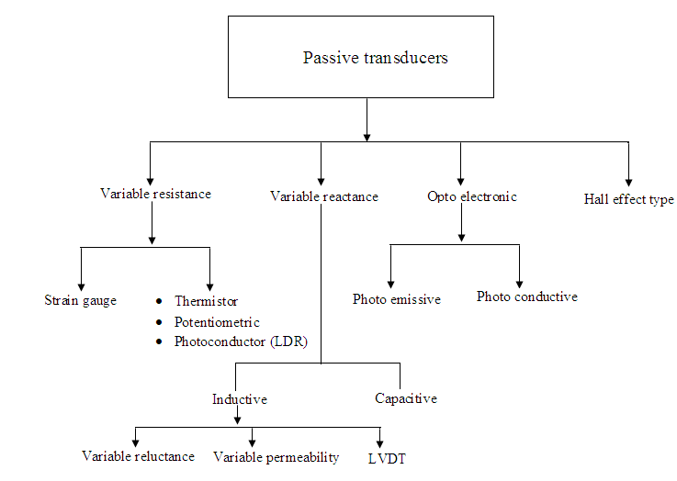
CLASSIFICATION OF PASSIVE TRANSDUCERS

Slide 15
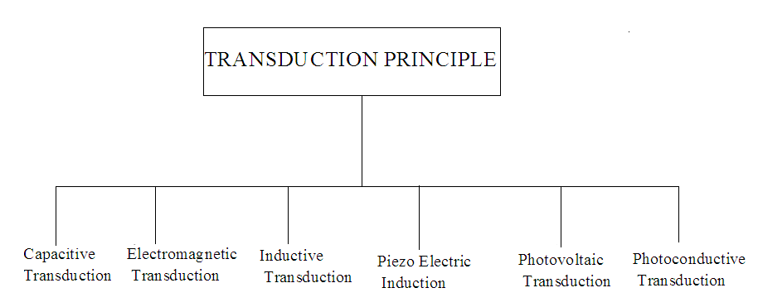
CLASSIFICATION OF TRANSDUCERS According to Transduction Principle

Slide 16
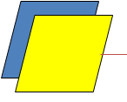
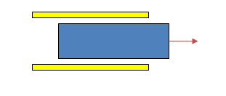
CLASSIFICATION OF TRANSDUCERS According to Transduction Principle
CAPACITIVE TRANSDUCER:
In capacitive transduction transducers the measurand is converted to a change in the capacitance.
• A typical capacitor is comprised of two parallel plates of conducting material separated by an electrical insulating material called a dielectric. The plates and the dielectric may be either flattened or rolled.
• The purpose of the dielectric is to help the two parallel plates maintain their stored electrical charges.
• The relationship between the capacitance and the size of capacitor plate, amount of plate separation, and the dielectric is given by
C = ε0 εr A / d
d is the separation distance of plates (m)
C is the capacitance (F, Farad)
ε0 : absolute permittivity of vacuum
εr : relative permittivity
A is the effective (overlapping) area of capacitor plates (m2)
d
Area=A
Either A, d or ε can be varied.

Slide 17
CLASSIFICATION OF TRANSDUCERS According to Transduction Principle
ELECTROMAGNETIC TRANSDUCTION:
* In electromagnetic transduction, the measurand is converted to voltage induced in conductor by change in the magnetic flux, in absence of excitation.
*The electromagnetic transducer are self generating active transducers.
*The motion between a piece of magnet and an electromagnet is responsible for the change in flux.

Slide 18
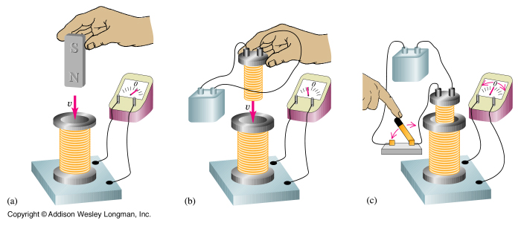
Current induced in a coil.

Slide 19
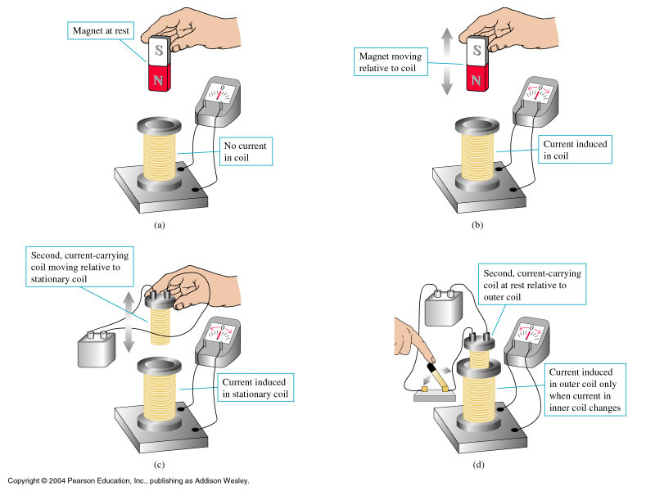

Slide 20
CLASSIFICATION OF TRANSDUCERS According to Transduction Principle
INDUCTIVE TRANSDUCER:
In inductive transduction, the measurand is converted into a change in the self inductance of a single coil. It is achieved by displacing the core of the coil that is attached to a mechanical sensing element

Slide 21
CLASSIFICATION OF TRANSDUCERS According to Transduction Principle
PIEZO ELECTRIC INDUCTION :
In piezoelectric induction the measurand is converted into a change in electrostatic charge q or voltage V generated by crystals when mechanically it is stressed as shown in fig.

Slide 22
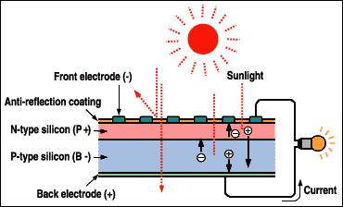
CLASSIFICATION OF TRANSDUCERS According to Transduction Principle
PHOTOVOLTAIC TRANSDUCTION :
In photovoltaic transduction the measurand is converted to voltage generated when the junction between dissimilar material is illuminated as shown in fig.

Slide 23
Physics of Photovoltaic Generation
n-type semiconductor
+ + + + + + + + + + + + + + +
Depletion Zone
- - - - - - - - - - - - - - - - - -
p-type semiconductor

Slide 24

CLASSIFICATION OF TRANSDUCERS According to Transduction Principle
PHOTO CONDUCTIVE TRANSDUCTION :
In photoconductive transduction the measurand is converted to change in resistance of semiconductor material by the change in light incident on the material.

Slide 25
PASSIVE TRANSDUCERS
Resistive transducers :
Resistive transducers are those transducers in which the resistance change due to the change in some physical phenomenon.
The resistance of a metal conductor is expressed by a simple equation.
R = ρL/A
Where R = resistance of conductor in Ω
L = length of conductor in m
A = cross sectional area of conductor in m²
ρ = resistivity of conductor material in Ω-m.

Slide 26
RESISTIVE TRANSDUCER
There are 4 type of resistive transducers.
Potentiometers (POT)
Strain gauge
Thermistors
Resistance thermometer

Slide 27
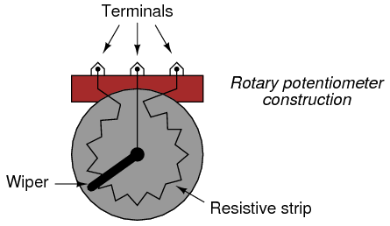
POTENTIOMETER
The potentiometer are used for voltage division. They consist of a resistive element provided with a sliding contact. The sliding contact is called as wiper.
The contact motion may be linear or rotational or combination of the two. The combinational potentiometer have their resistive element in helix form and are called helipots.
Fig shows a linear pot and a rotary pot.

Slide 28
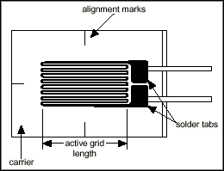
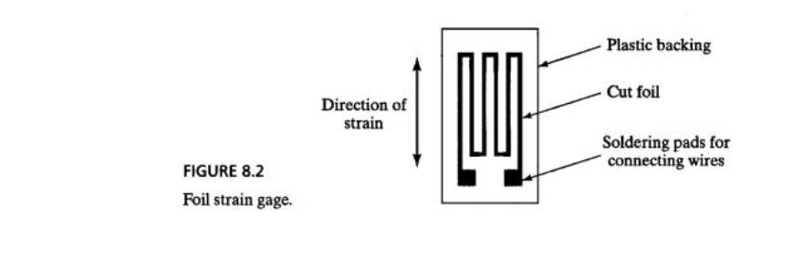
STRAIN GAUGE
The strain gauge is a passive, resistive transducer which converts the mechanical elongation and compression into a resistance change.
This change in resistance takes place due to variation in length and cross sectional area of the gauge wire, when an external force acts on it.

Slide 29
TYPES OF STRAIN GAUGE
The type of strain gauge are as
Wire gauge
Unbonded
Bonded
Foil type
Semiconductor gauge

Slide 30
RESISTANCE THERMOMETER
Resistance of metal increase with increases in temperature. Therefore metals are said to have a positive temperature coefficient of resistivity.
Fig shows the simplest type of open wire construction of platinum résistance thermometer. The platinum wire is wound in the form of spirals on an insulating material such as mica or ceramic.
This assembly is then placed at the tip of probe.
This wire is in direct contact with the gas or liquid whose temperature is to be measured.

Slide 31
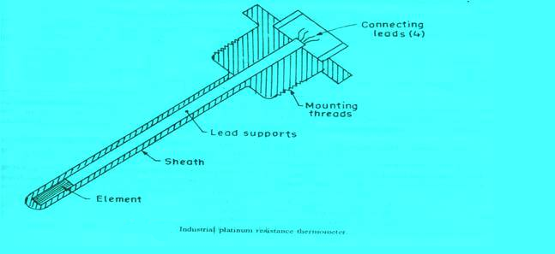
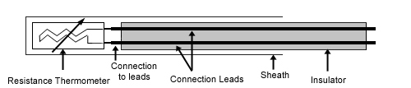

Slide 32
The resistance of the platinum wire changes with the change in temperature of the gas or liquid
This type of sensor have a positive temperature coefficient of resistivity as they are made from metals they are also known as resistance temperature detector
Resistance thermometer are generally of probe type for immersion in medium whose temperature is to be measured or controlled.

Slide 33
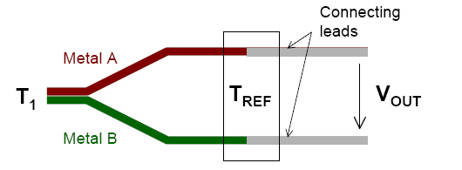
Thermocouples
See beck Effect
When a pair of dissimilar metals are joined at one end, and there is a temperature difference between the joined ends and the open ends, thermal emf is generated, which can be measured in the open ends.
This forms the basis of thermocouples.

Slide 34
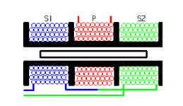
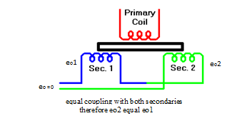
LINEAR VARIABLE DIFFERENTIAL TRANSFORMER(LVDT)
AN LVDT transducer comprises a coil former on to which three coils are wound.
The primary coil is excited with an AC current, the secondary coils are wound such that when a ferrite core is in the central linear position, an equal voltage is induced in to each coil.
The secondary are connected in opposite so that in the central position the outputs of the secondary cancels each other out.

Slide 35
The excitation is applied to the primary winding and the armature assists the induction of current in to secondary coils.
When the core is exactly at the center of the coil then the flux linked to both the secondary winding will be equal. Due to equal flux linkage the secondary induced voltages (eo1 & eo2) are equal but they have opposite polarities. Output voltage eo is therefore zero. This position is called “null position”

Slide 37
Now if the core is displaced from its null position toward sec1 then flux linked to sec1 increases and flux linked to sec2 decreases. Therefore eo1 > eo2 and the output voltage of LVDT eo will be positive
Similarly if the core is displaced toward sec2 then the eo2 > eo1 and the output voltage of LVDT eo will be negative.

